Slide 1
Tilt-Shift Photography
Noelpratt

Slide 2
Tilt-sift Photo
Tilt–shift photography is the use of camera movements on small- and medium-format cameras, and sometimes specifically refers to the use of tilt for selective focus, often for simulating a miniature scene. Sometimes the term is used when the large depth of field is simulated with digital post-processing; the name may derive from the tilt–shift lens normally required when the effect is produced optically.

Slide 3
,

Slide 4
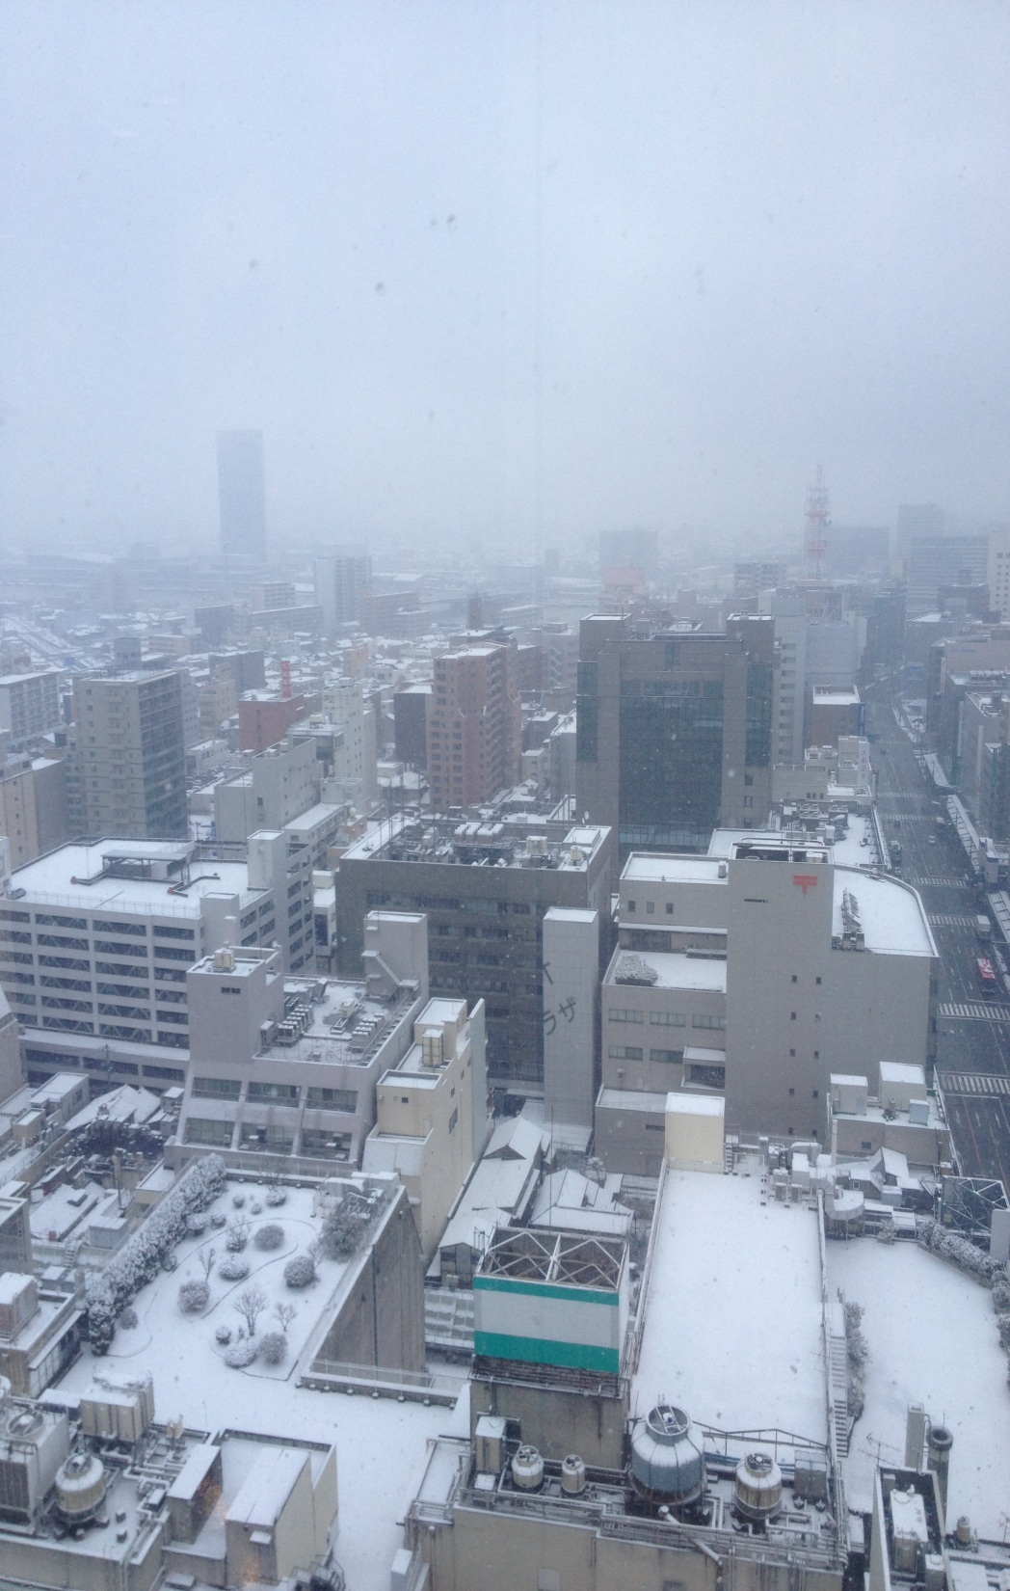
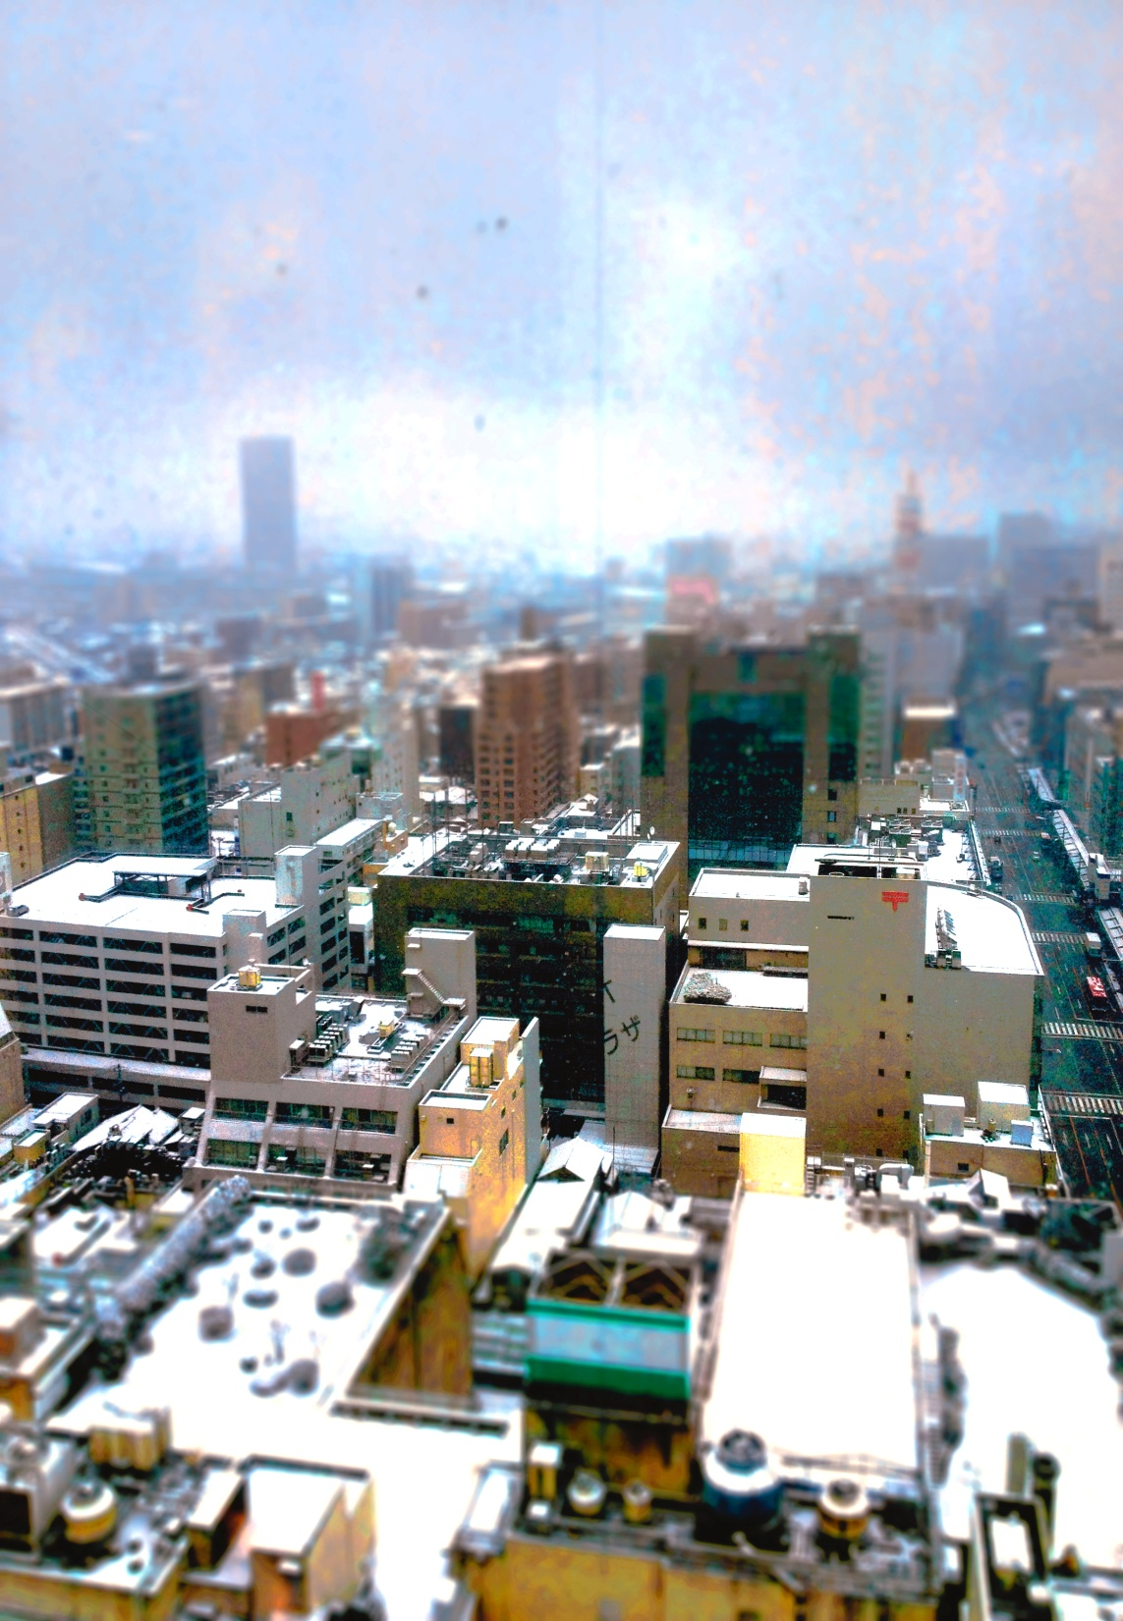
,

Slide 5
Sources
http://mashable.com/2013/09/24/photoshop-tilt-shift/
http://www.photoshopessentials.com/photo-effects/miniature-tilt-shift-cs6/
https://www.youtube.com/watch?v=qflNQ2H4hv4

