Slide 1
Night/Long Exposure Photography

Slide 2
What is it?
When you use a longer shutter speed in a night time setting to capture moving light sources causing it to become visible
The longer the camera shutter is open, more light is absorbed making a brighter photo

Slide 3
What you need…
Preferably a camera with bulb mode so you can control how long the shutter is open
A vibration reduction lens so a little bit of moment wont affect the picture
A tripod to keep the camera steady
A road with lots of moving traffic

Slide 4
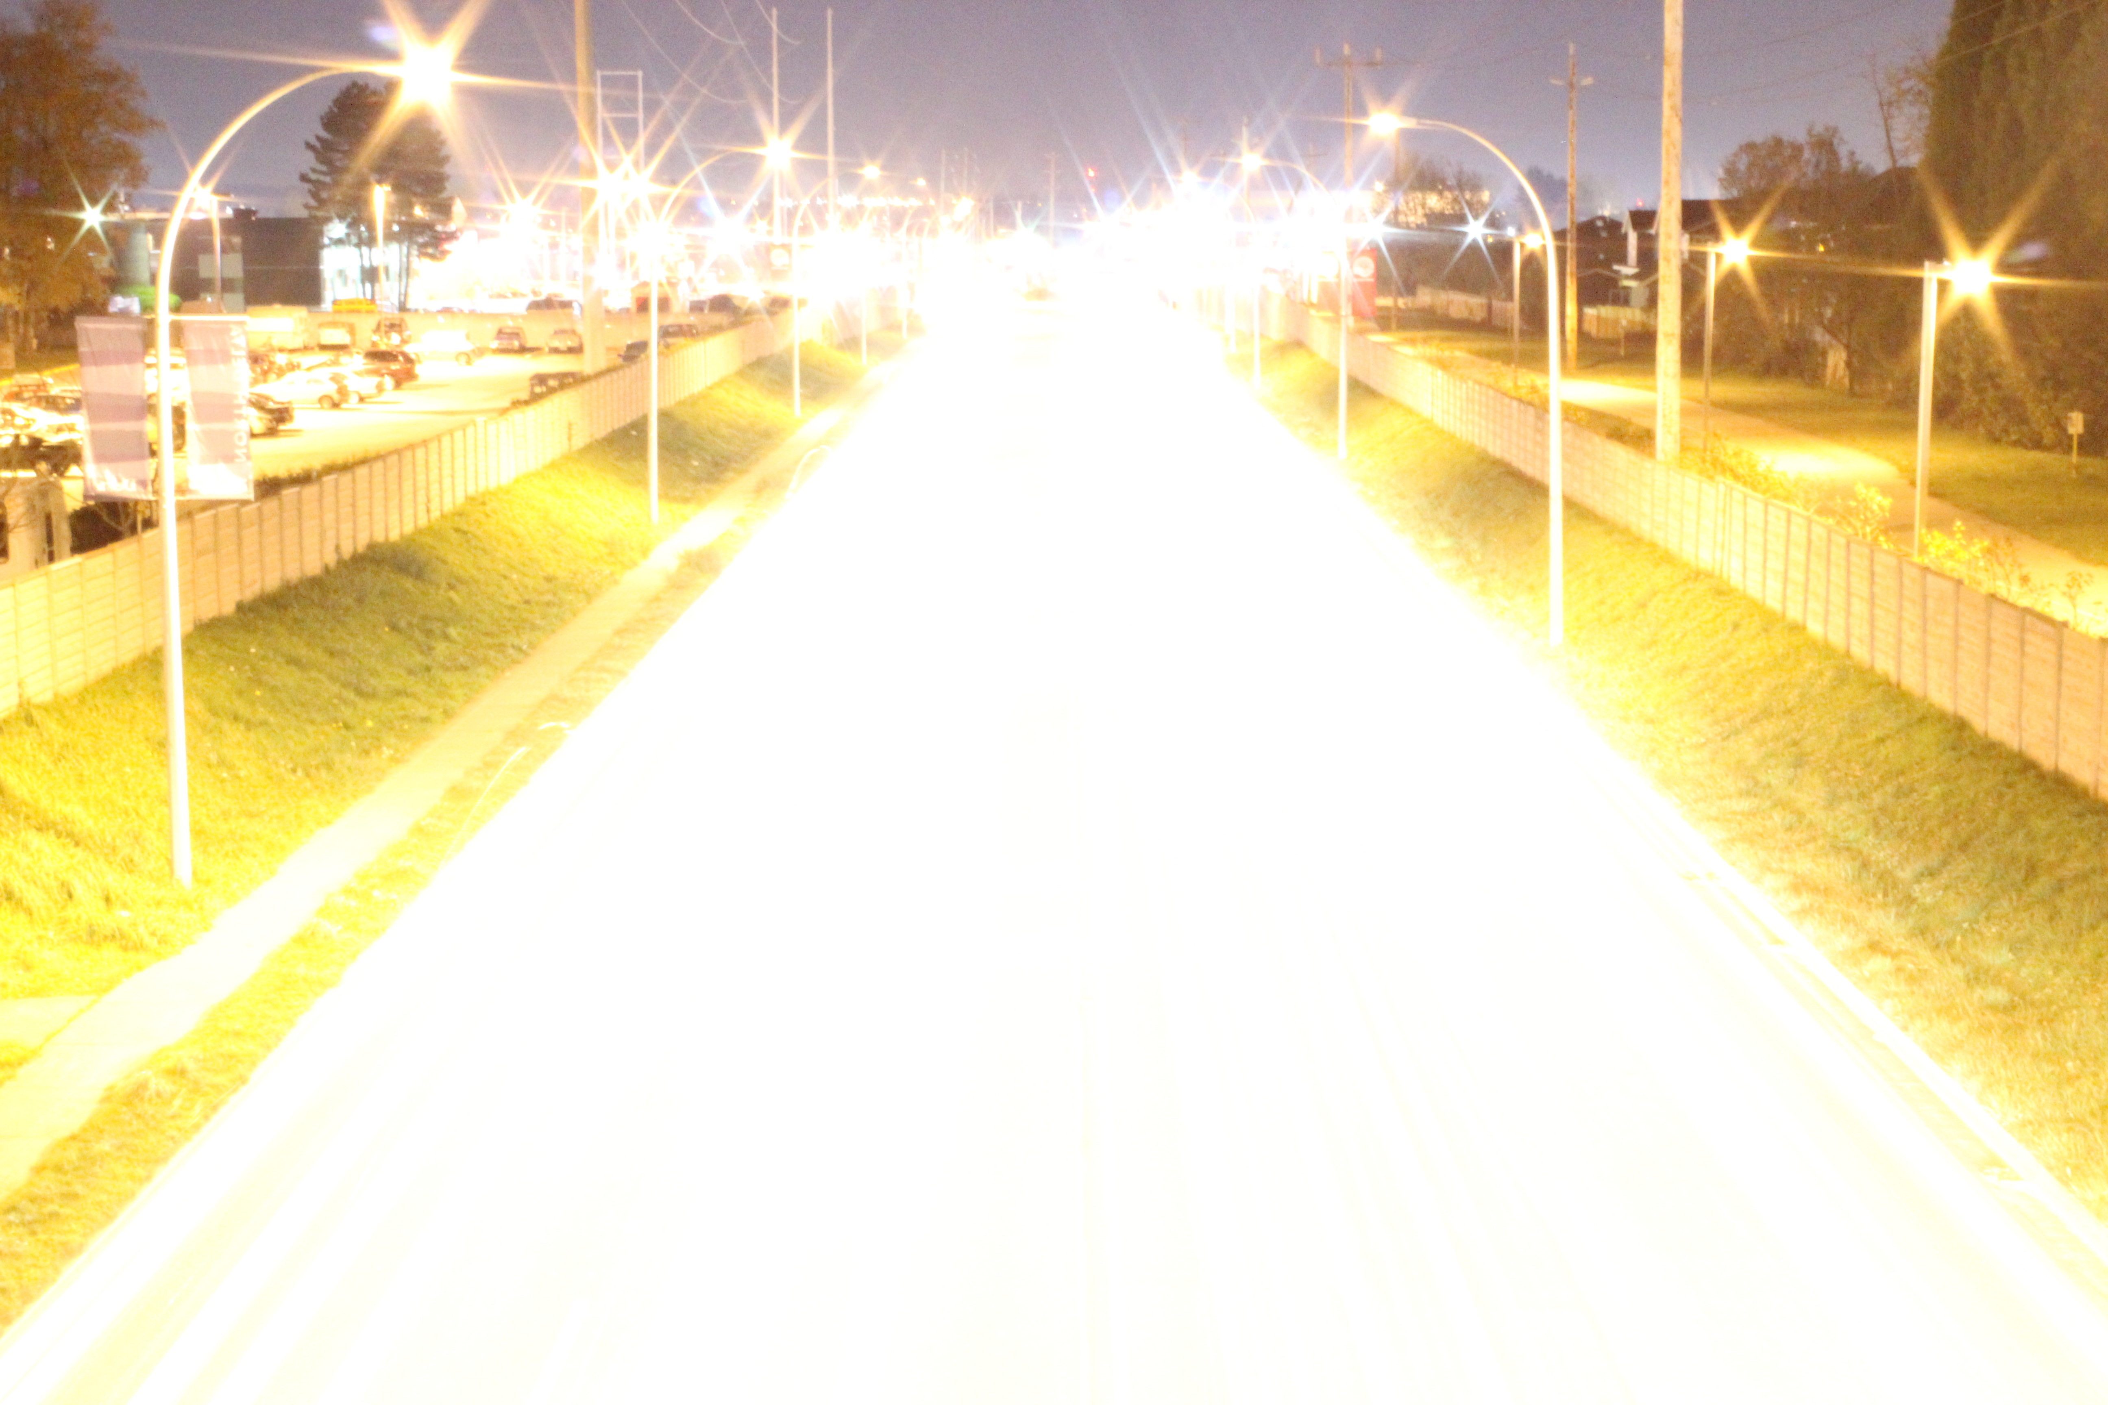
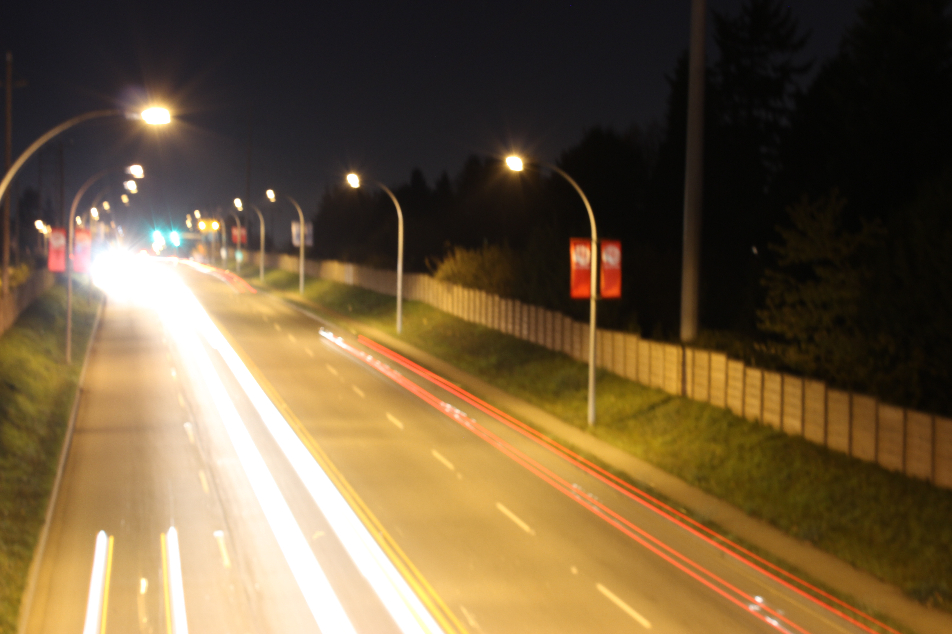
How to do it…
Put camera on tripod
Set camera to shutter priority mode or bulb mode. If you don’t have bulb mode set the shutter speed to 10-15 seconds or depending on how much light you want in the photo.
Find a good area like the side of a busy street or an overpass and try to focus
Wait for perfect moment=lots of moving traffic
Set a 2 sec self timer to avoid shake when pressing the shutter
Take perfect photo

Slide 5
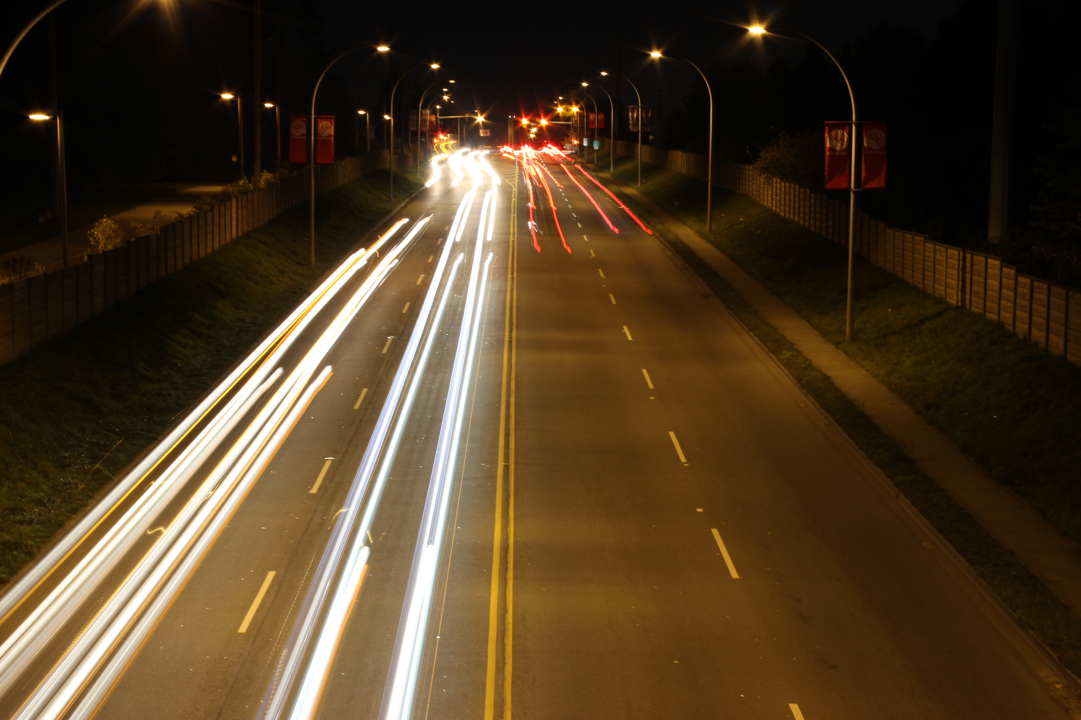
f/10
10 sec
iso 200
f/16
10 sec
iso 200

Slide 6
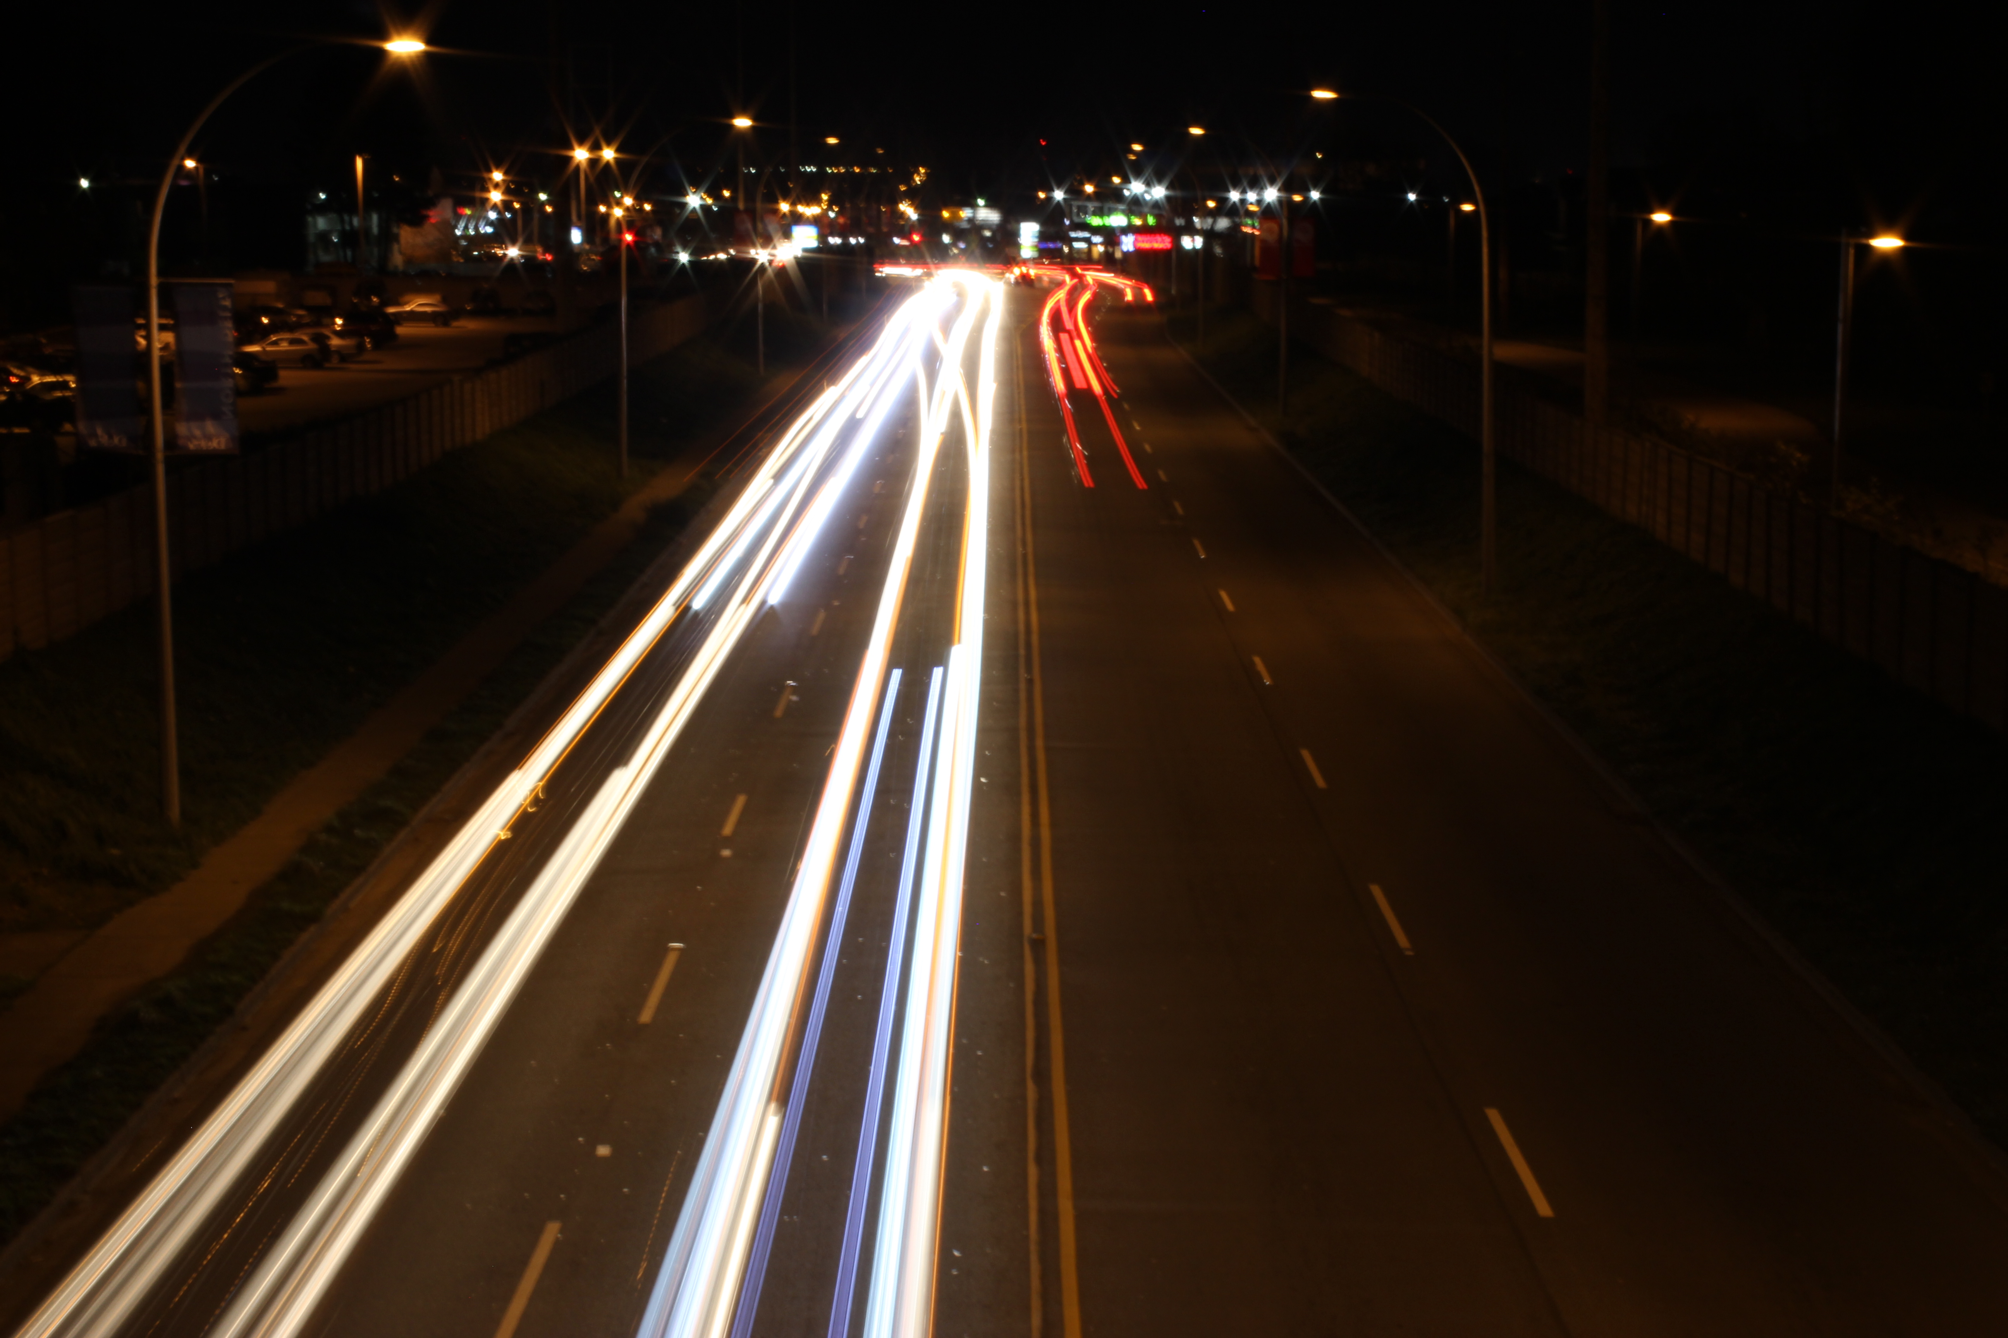
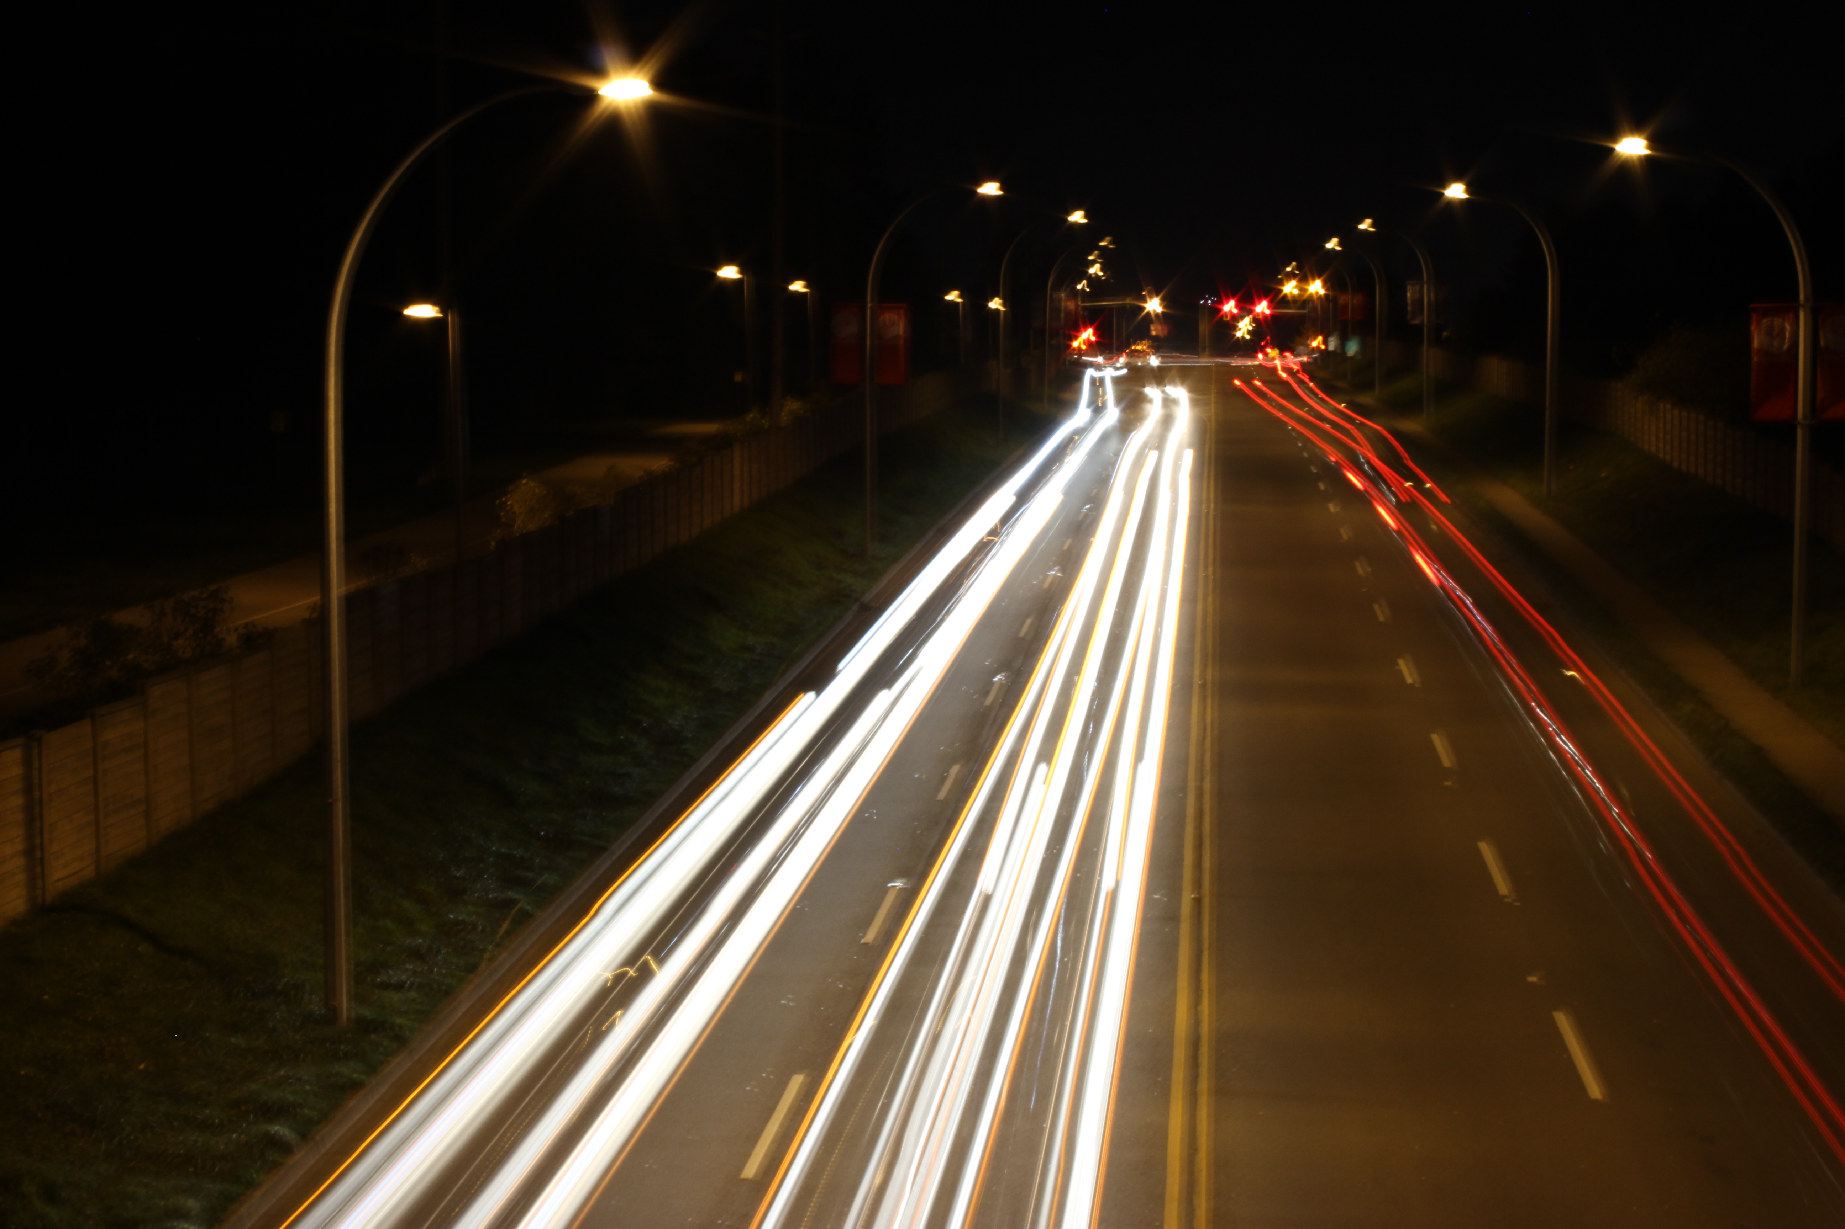
f/29
10 sec
Iso 200
f/20
10 sec
Iso 200

Slide 7
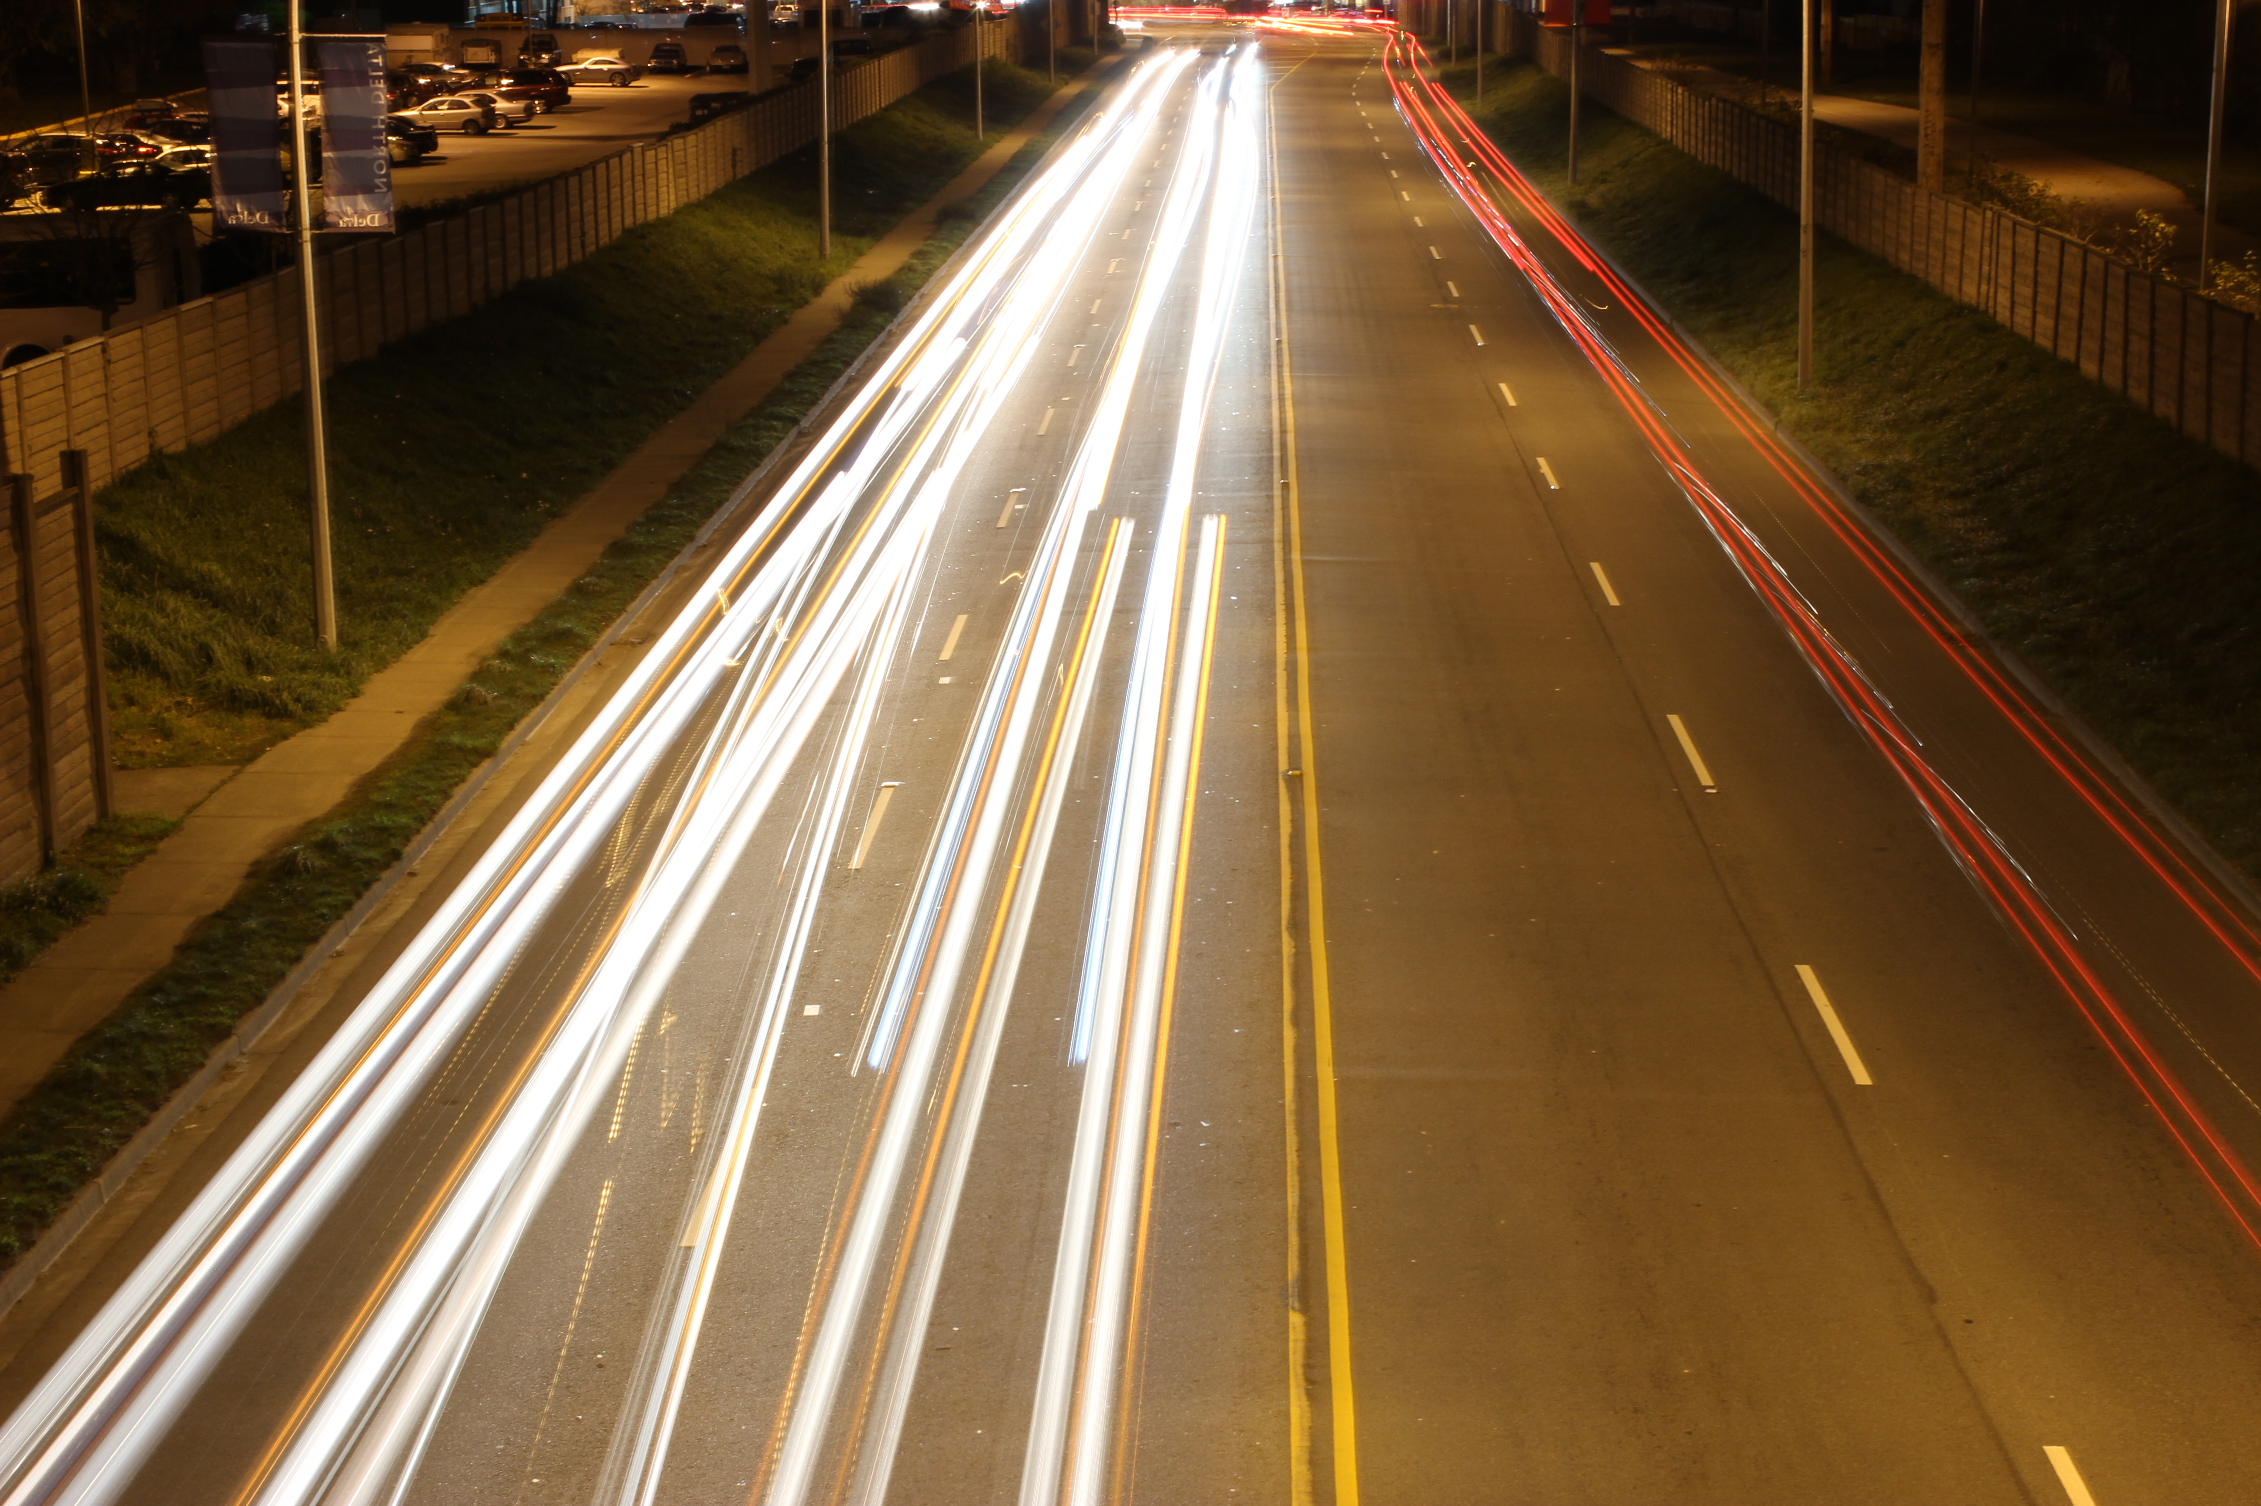
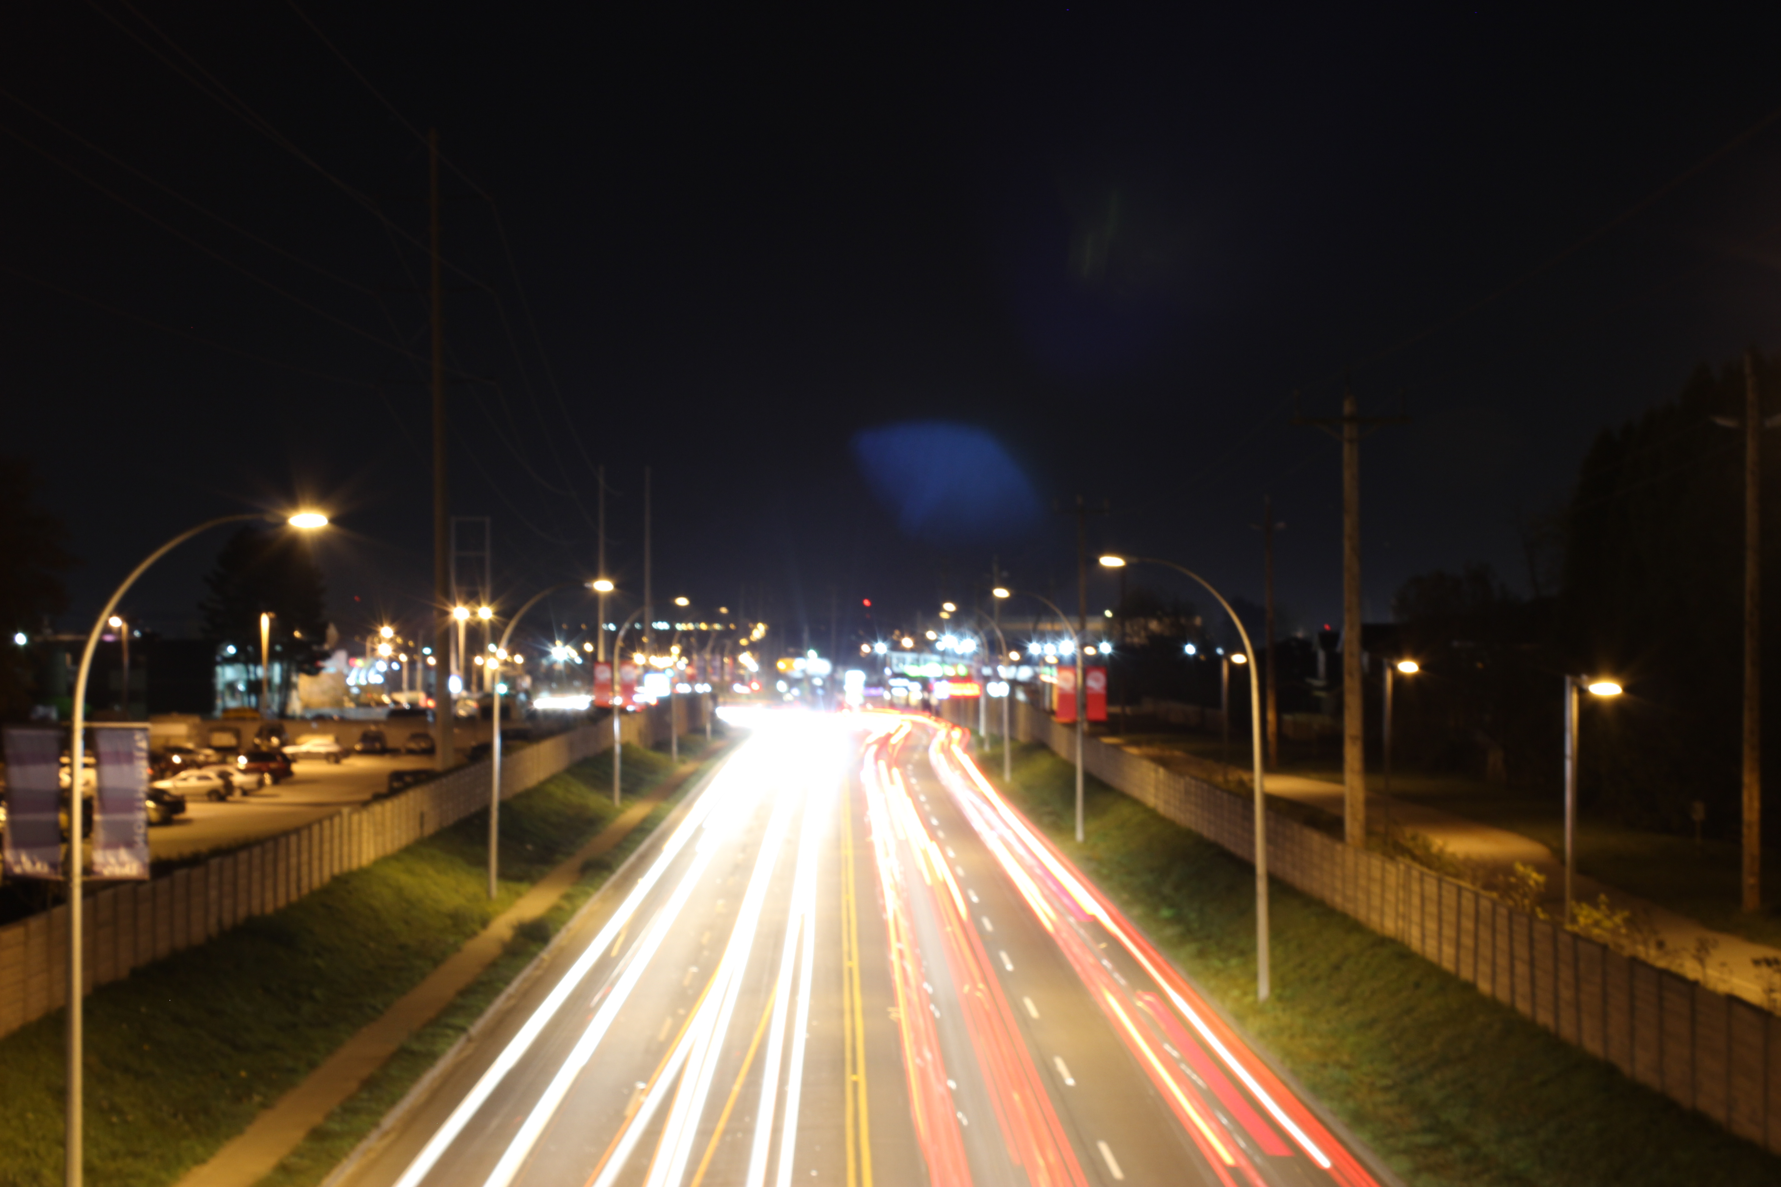
f/14
10 sec
Iso 200
f/10
10 sec
Iso 200

