Slide 1
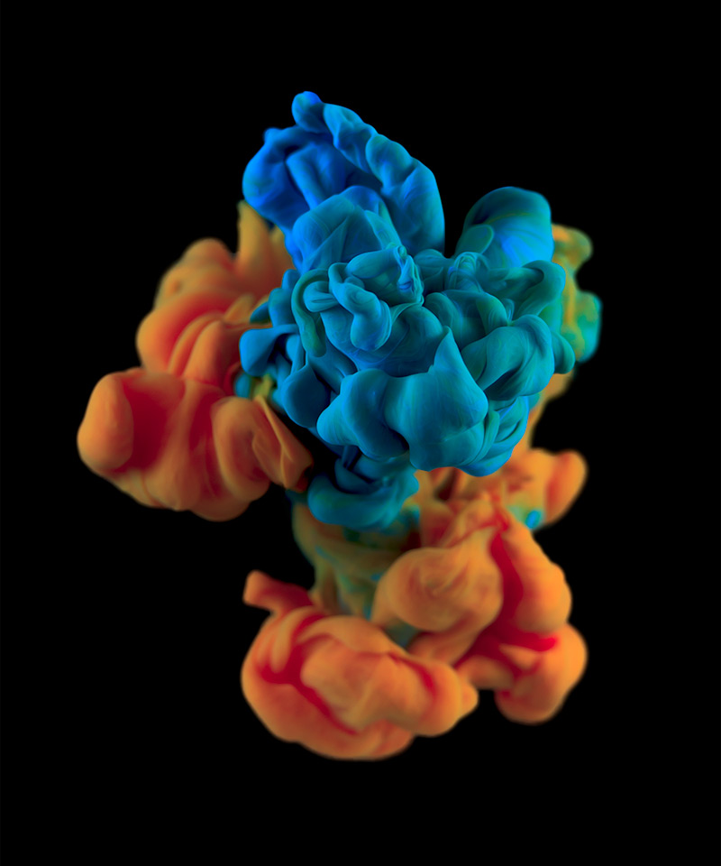
High Speed Photography
Addam Mah

Slide 2
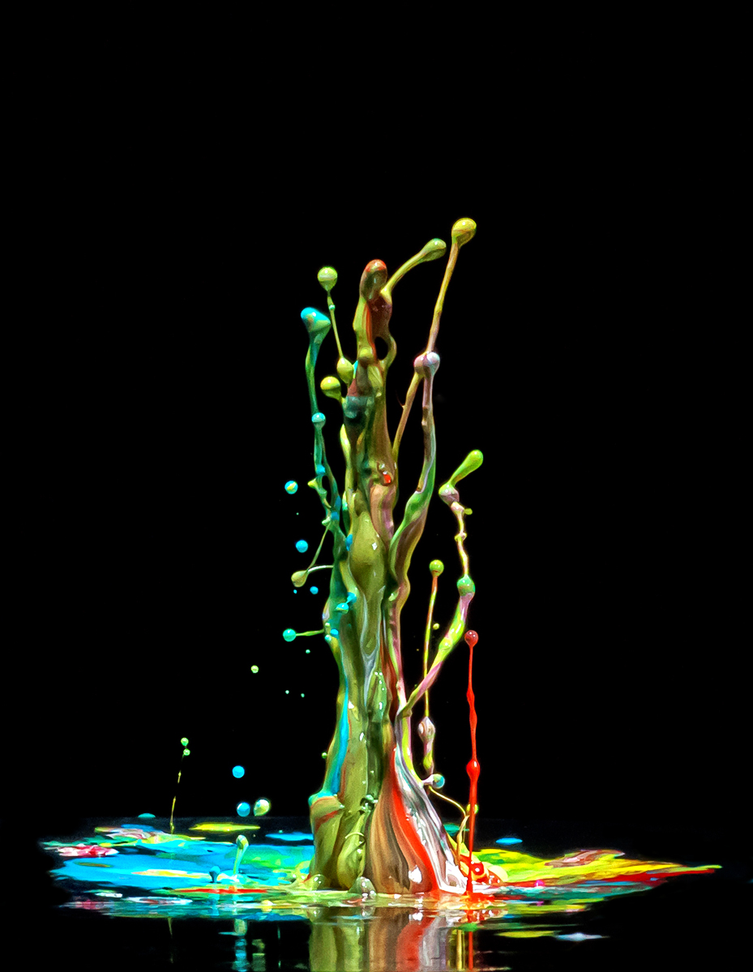
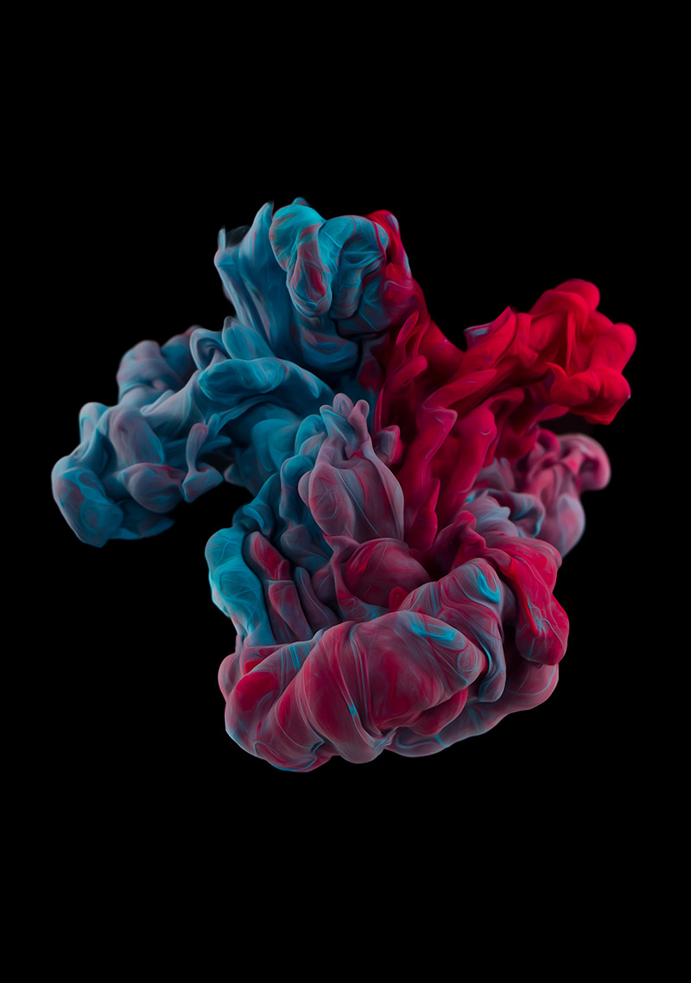
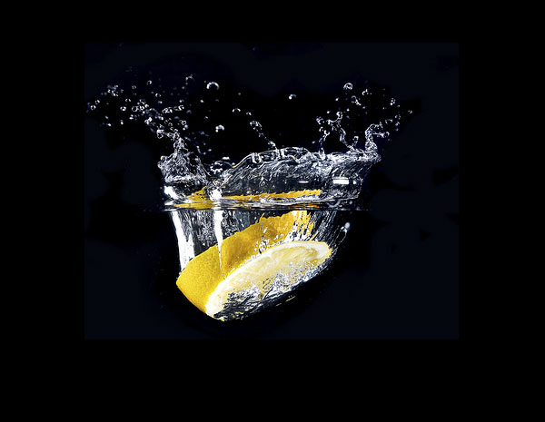
What is high speed photography?
High speed photography is the science of taking pictures of a very fast phenomena

Slide 3
Materials You Need:
Acrylic Ink
Fish tank or see-through container
Water
Tripod
2-3 Flashes
Black or white back round

Slide 4
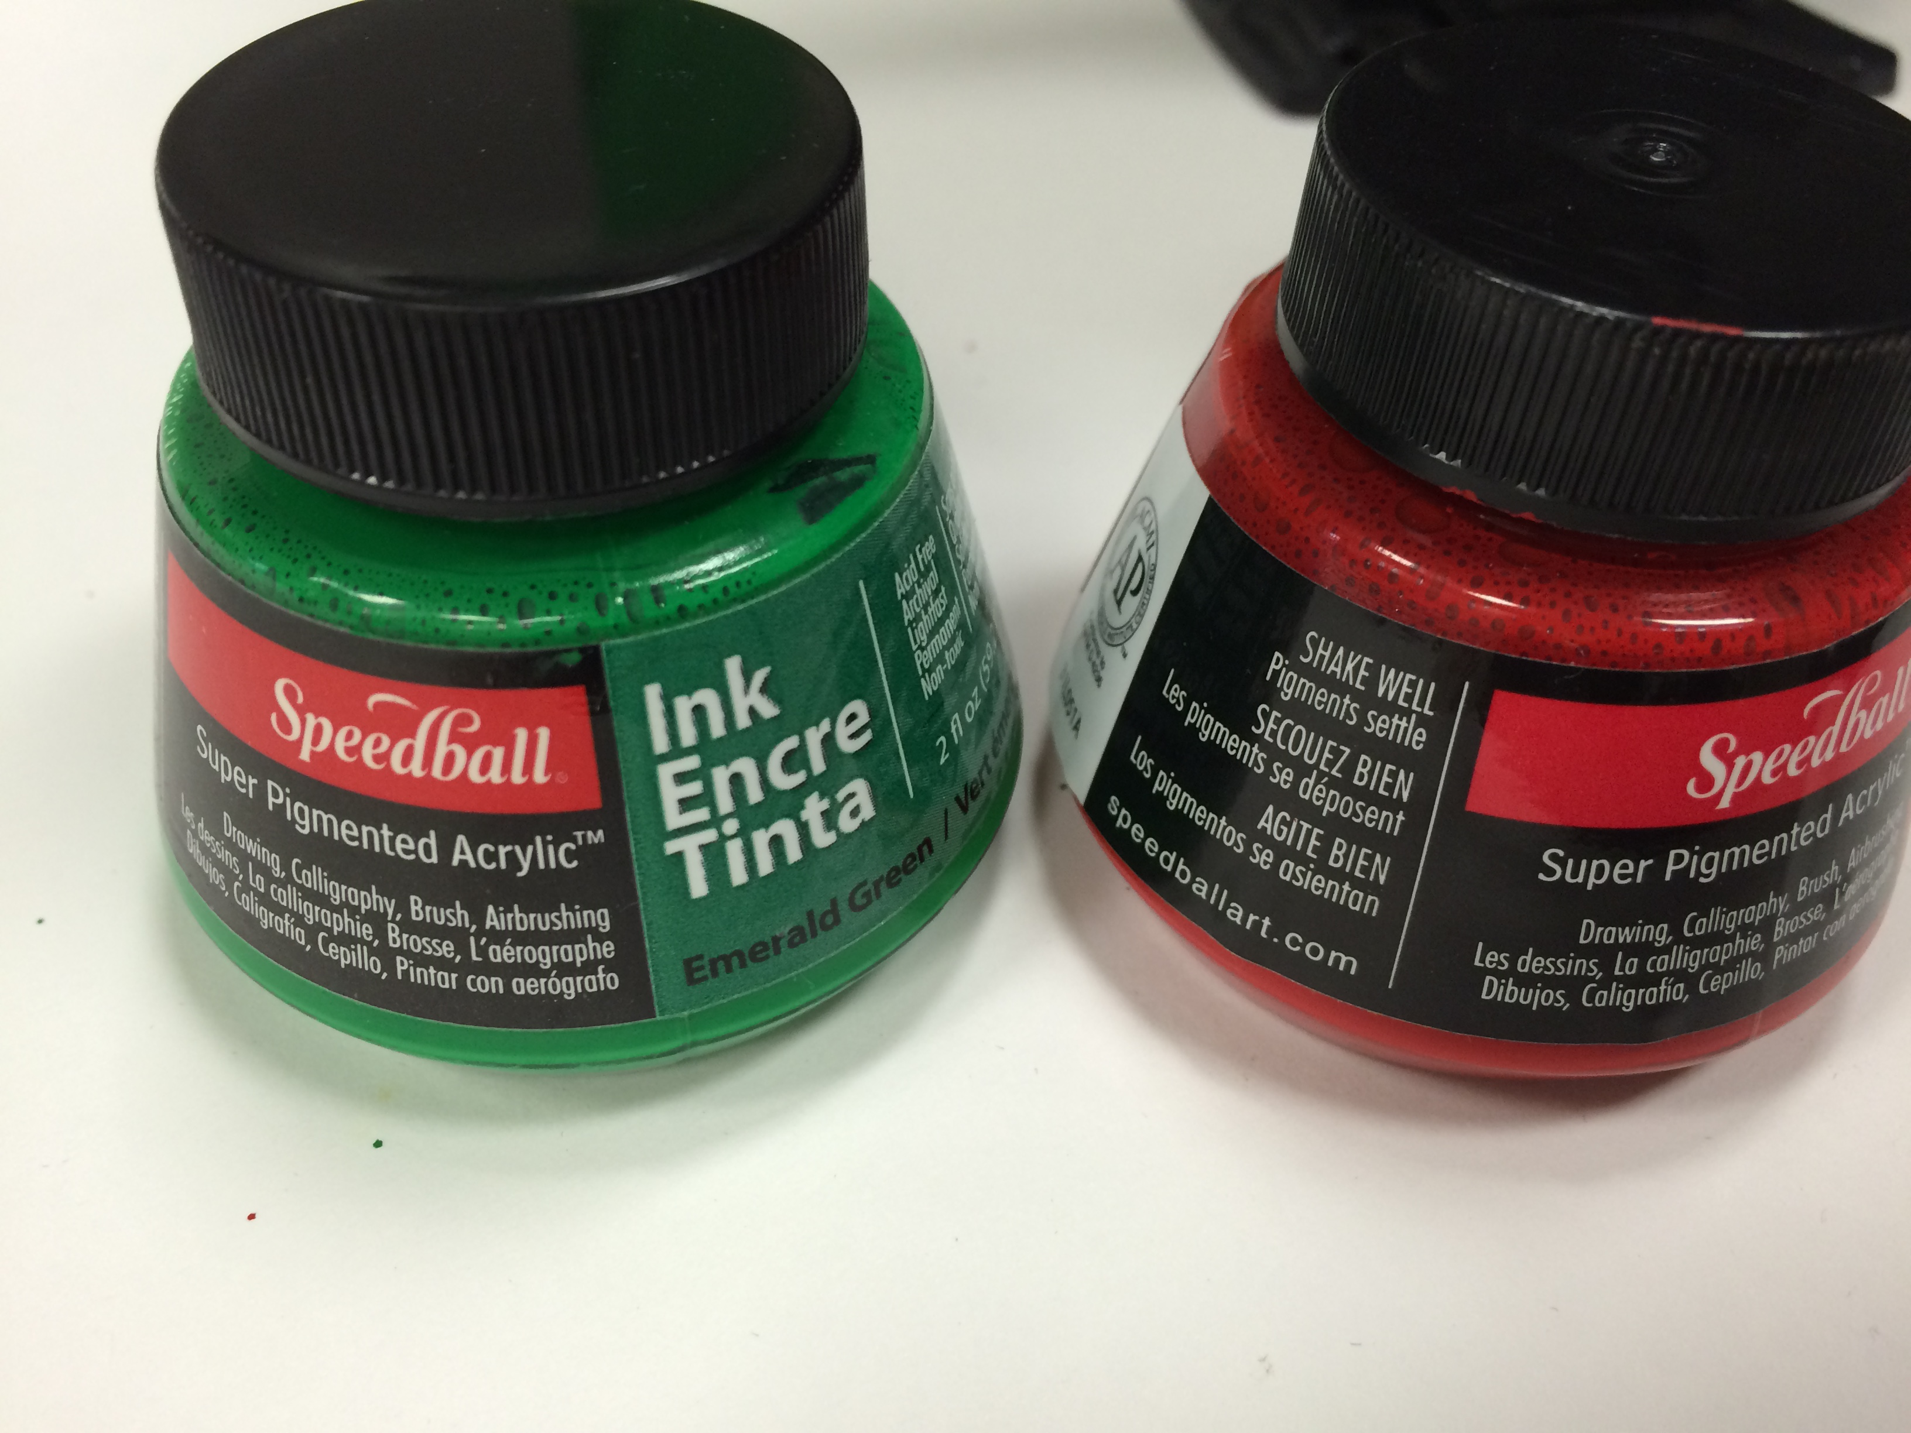
Steps To Follow:
Fill your fish tank/container full of water
Put a black piece of paper behind the container (optional)
Set up your flashes
Set your camera to the right settings
Put an item in the water so the camera can focus on the water
Drop the ink into the water and start shooting

Slide 5
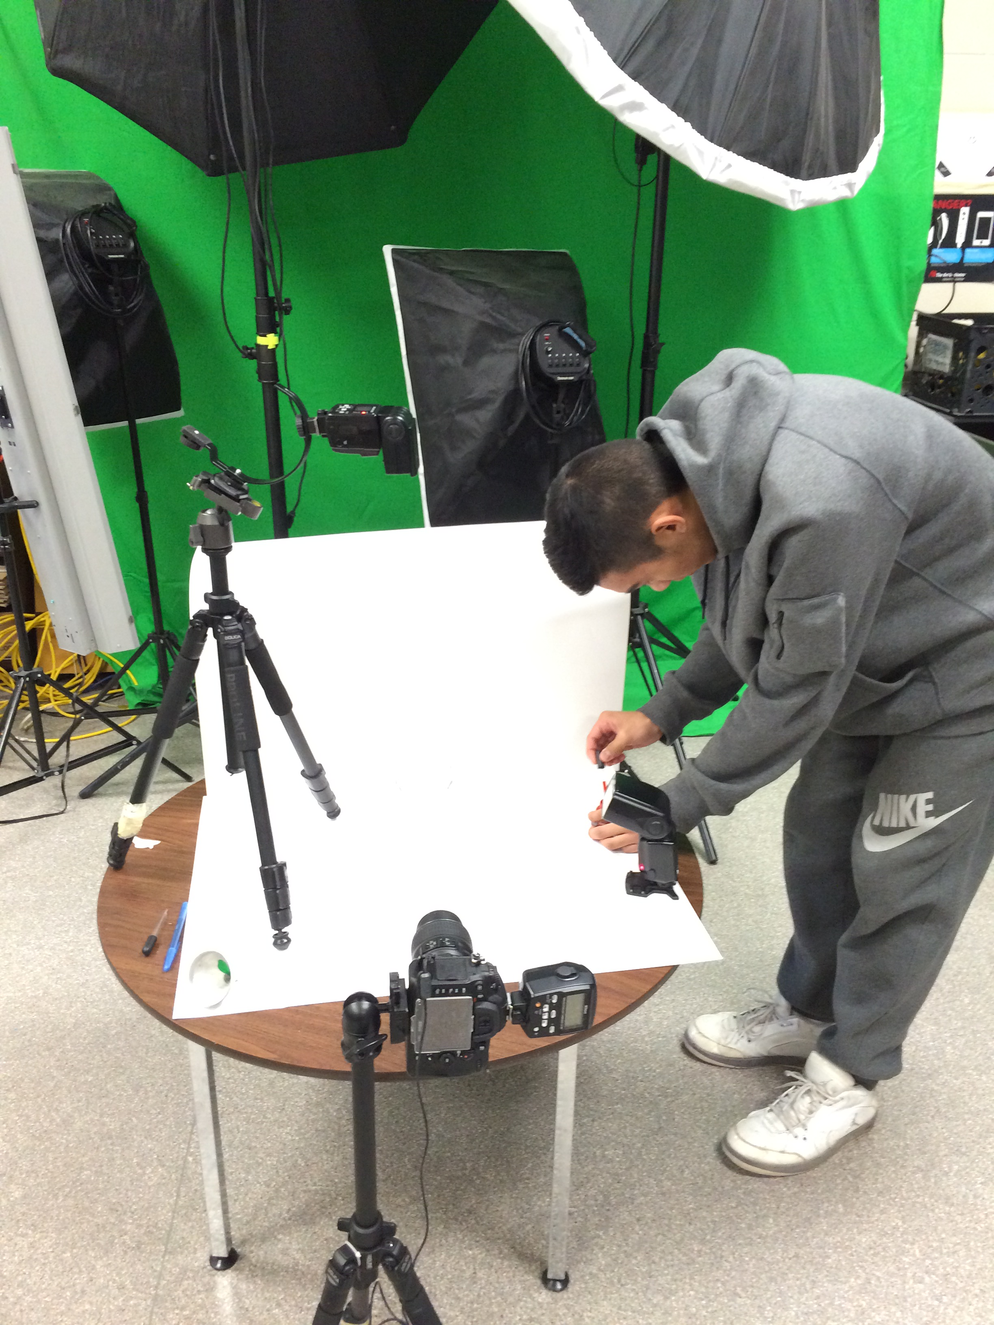
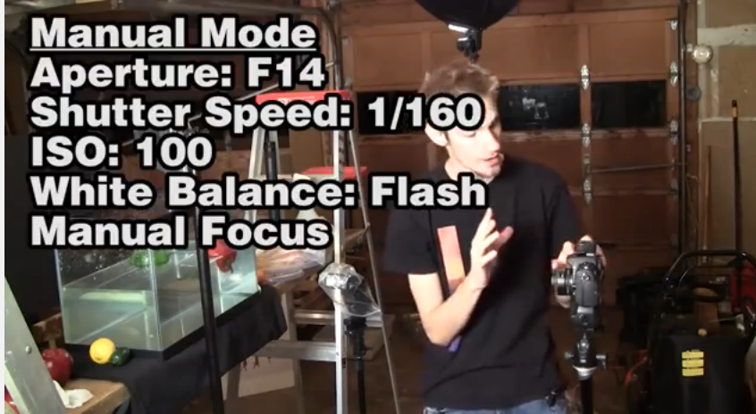
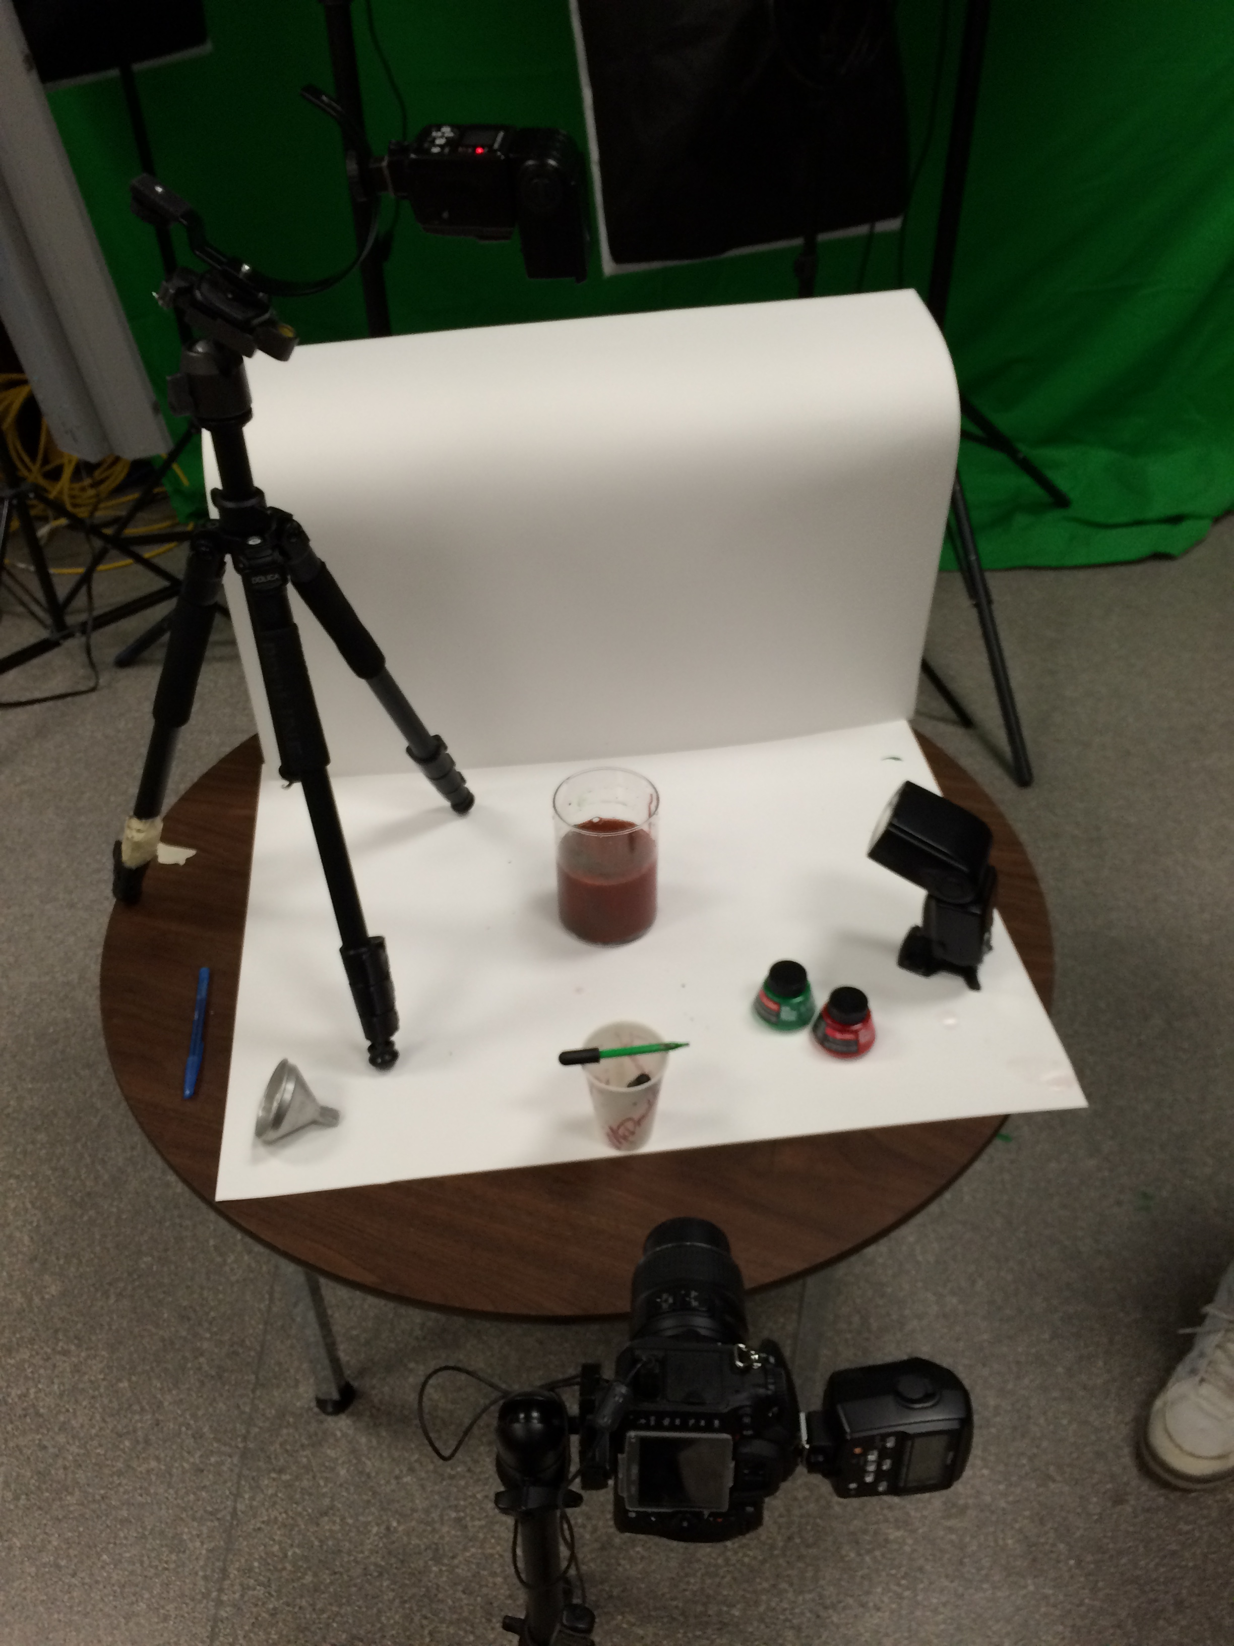
The Setup & Settings:

Slide 6
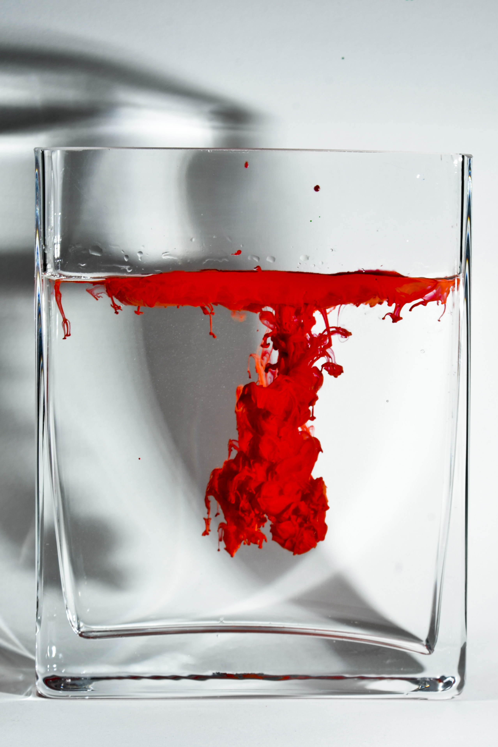
Results:

Slide 9
What went well and what didn’t?
Good:
1.)Using glass container rather than plastic
2.) The bigger the container the better effect
3.) Works better if the container is flat not round
Bad:
1.) Round or small container
2.)Dropping the ink at a slow pace
3.) pictures were blurry when we used round object

Slide 10
Resources:
http://www.thisiscolossal.com/2014/04/new-underwater-ink-plumes-photographed-by-alberto-seveso

